Slide 1
BSU Tour App
Douglas Tucker and Chinwendum Njoku

Slide 2

Concept
An Easy to use alternative to live on campus tours. Users have the ability to learn about the campus remotely or as a self guided tour on campus using a map on the Mobile application.

Slide 3
Development plan
Markers
Audio player
Mapping
location page
Geo Fencing
Have map create location markers for each list item
Despite being red, Mars is a cold place, not hot
1
2
3
4
5
Add a working map to our basic list program
Display location information
Create triggers to open location pages

Slide 4
Implementation Progress
Starter code using HW 2 and 3
List Hard coded location data
Map Fragment creation
Markers from list data
List to model class
Rotation Persistence
Campus Fence location
Location Page Activity
Click listeners
Multi lists and Spinners
Audio controls

Slide 5
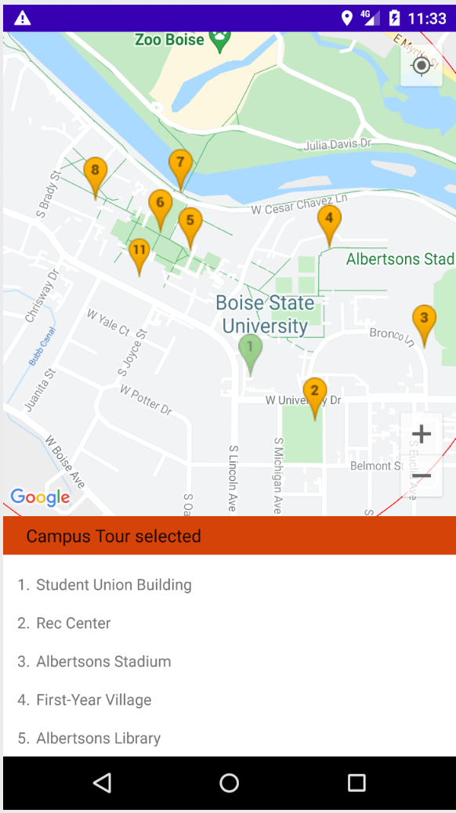
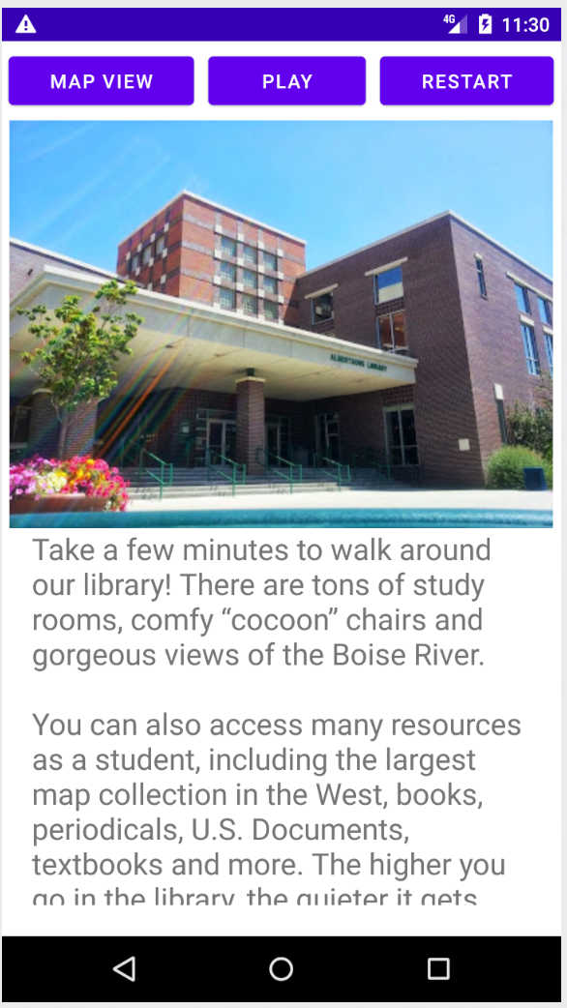
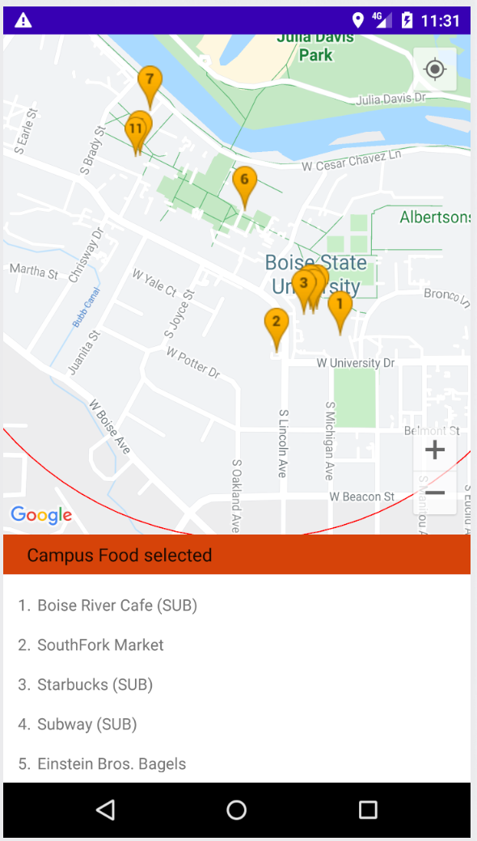
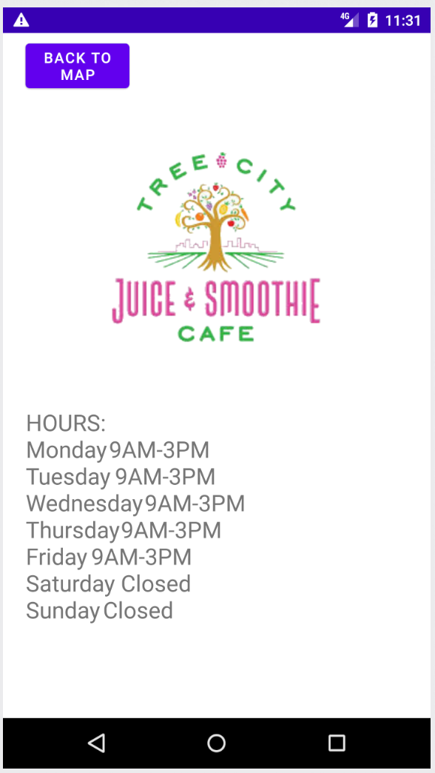
APP in action

